Slide 1
Group 50 Machine learning
Rose, Kareem, Bedirhan, Amla, Shivam

Slide 2
Loading and plotting a heart failure prediction dataset

Slide 3
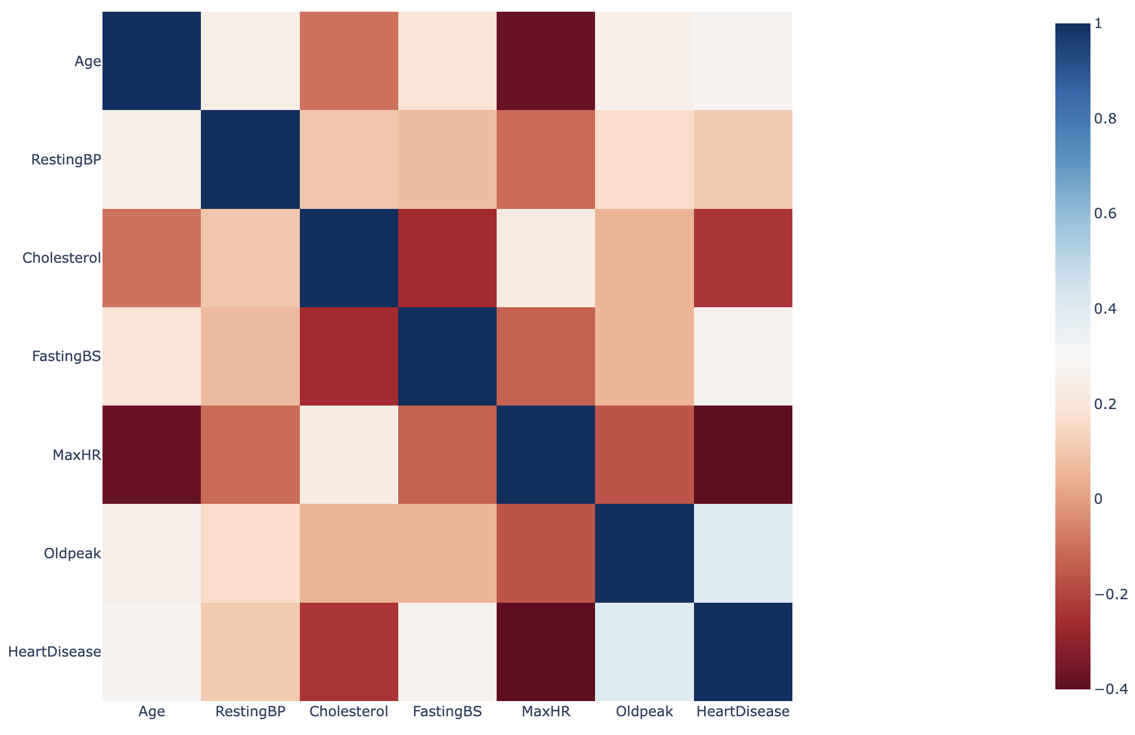
Correlation matrix
Summarizes the correlation between two variables
Strong correlation: if one value increases, the other value increases too
Negative correlation: if one value increases, the other decreases.
No strong correlation in our matrix (no values close to 1)

Slide 4
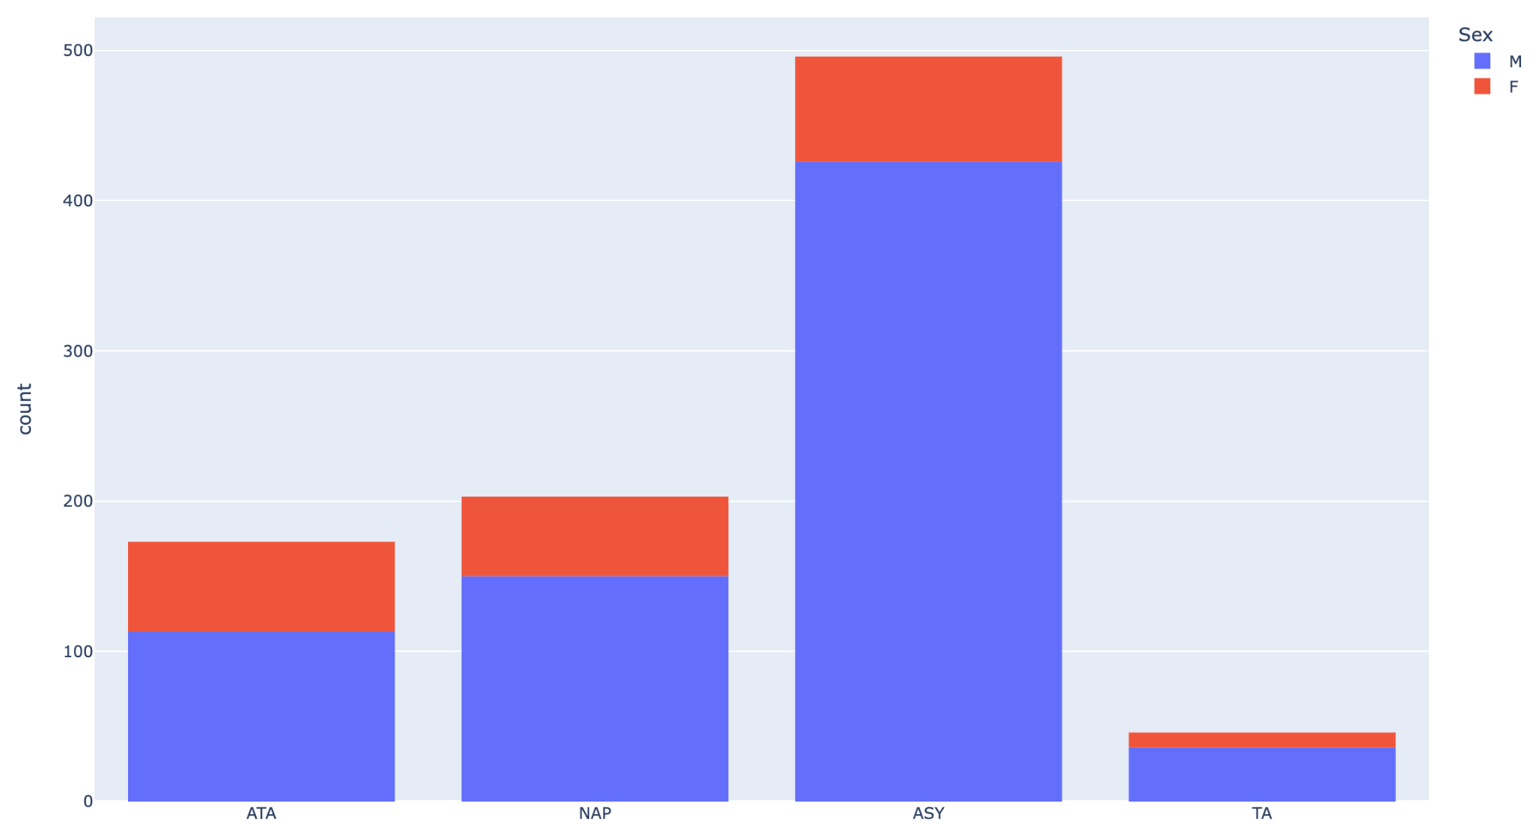
Types of chest pain
Distribution of chest pains between M and F
Types:
ATA: Atypical Angina
NAP: Non-Anginal Pain
ASY: Asymptomatic
TA: Typical Angina
Asymptomatic chest pain highest for male and female

Slide 5
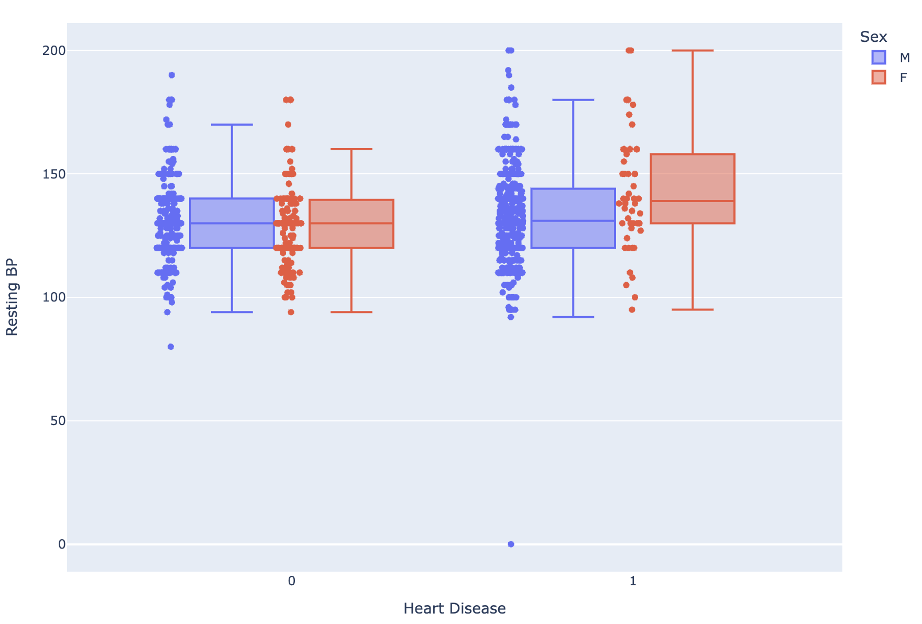
Resting blood pressure distribution
Slight correlation between resting BP and heart disease
0: No heart disease
1: Heart disease
Female with heart disease have higher resting blood pressure compared to male
Less observations recorded for females with heart disease (seen by data points)

Slide 6
End

